Slide 1


Introduction to Operating Systems CS 1550
Spring 2023
Sherif Khattab
ksm73@pitt.edu
(Some slides are from Silberschatz, Galvin and Gagne ©2013)

Slide 2
Announcements
Upcoming deadlines
All deadlines moved to Monday May 1st at 11:59 pm
But please don’t wait to last minute!
Homework 11, 12, Bonus Homework
Lab 4 and Lab 5
Quiz 3 and Quiz 4
Project 4 (no late deadline)
Post-Course Quiz (1 bonus point)

Slide 3
Previous lecture …
How to allocate disk blocks to files and directories?
linked, FAT, indexed, and hybrid
file directories
free block tracking

Slide 4
This lecture …
How does a file system handle errors?
How does a file system hide disk access delays?

Slide 5
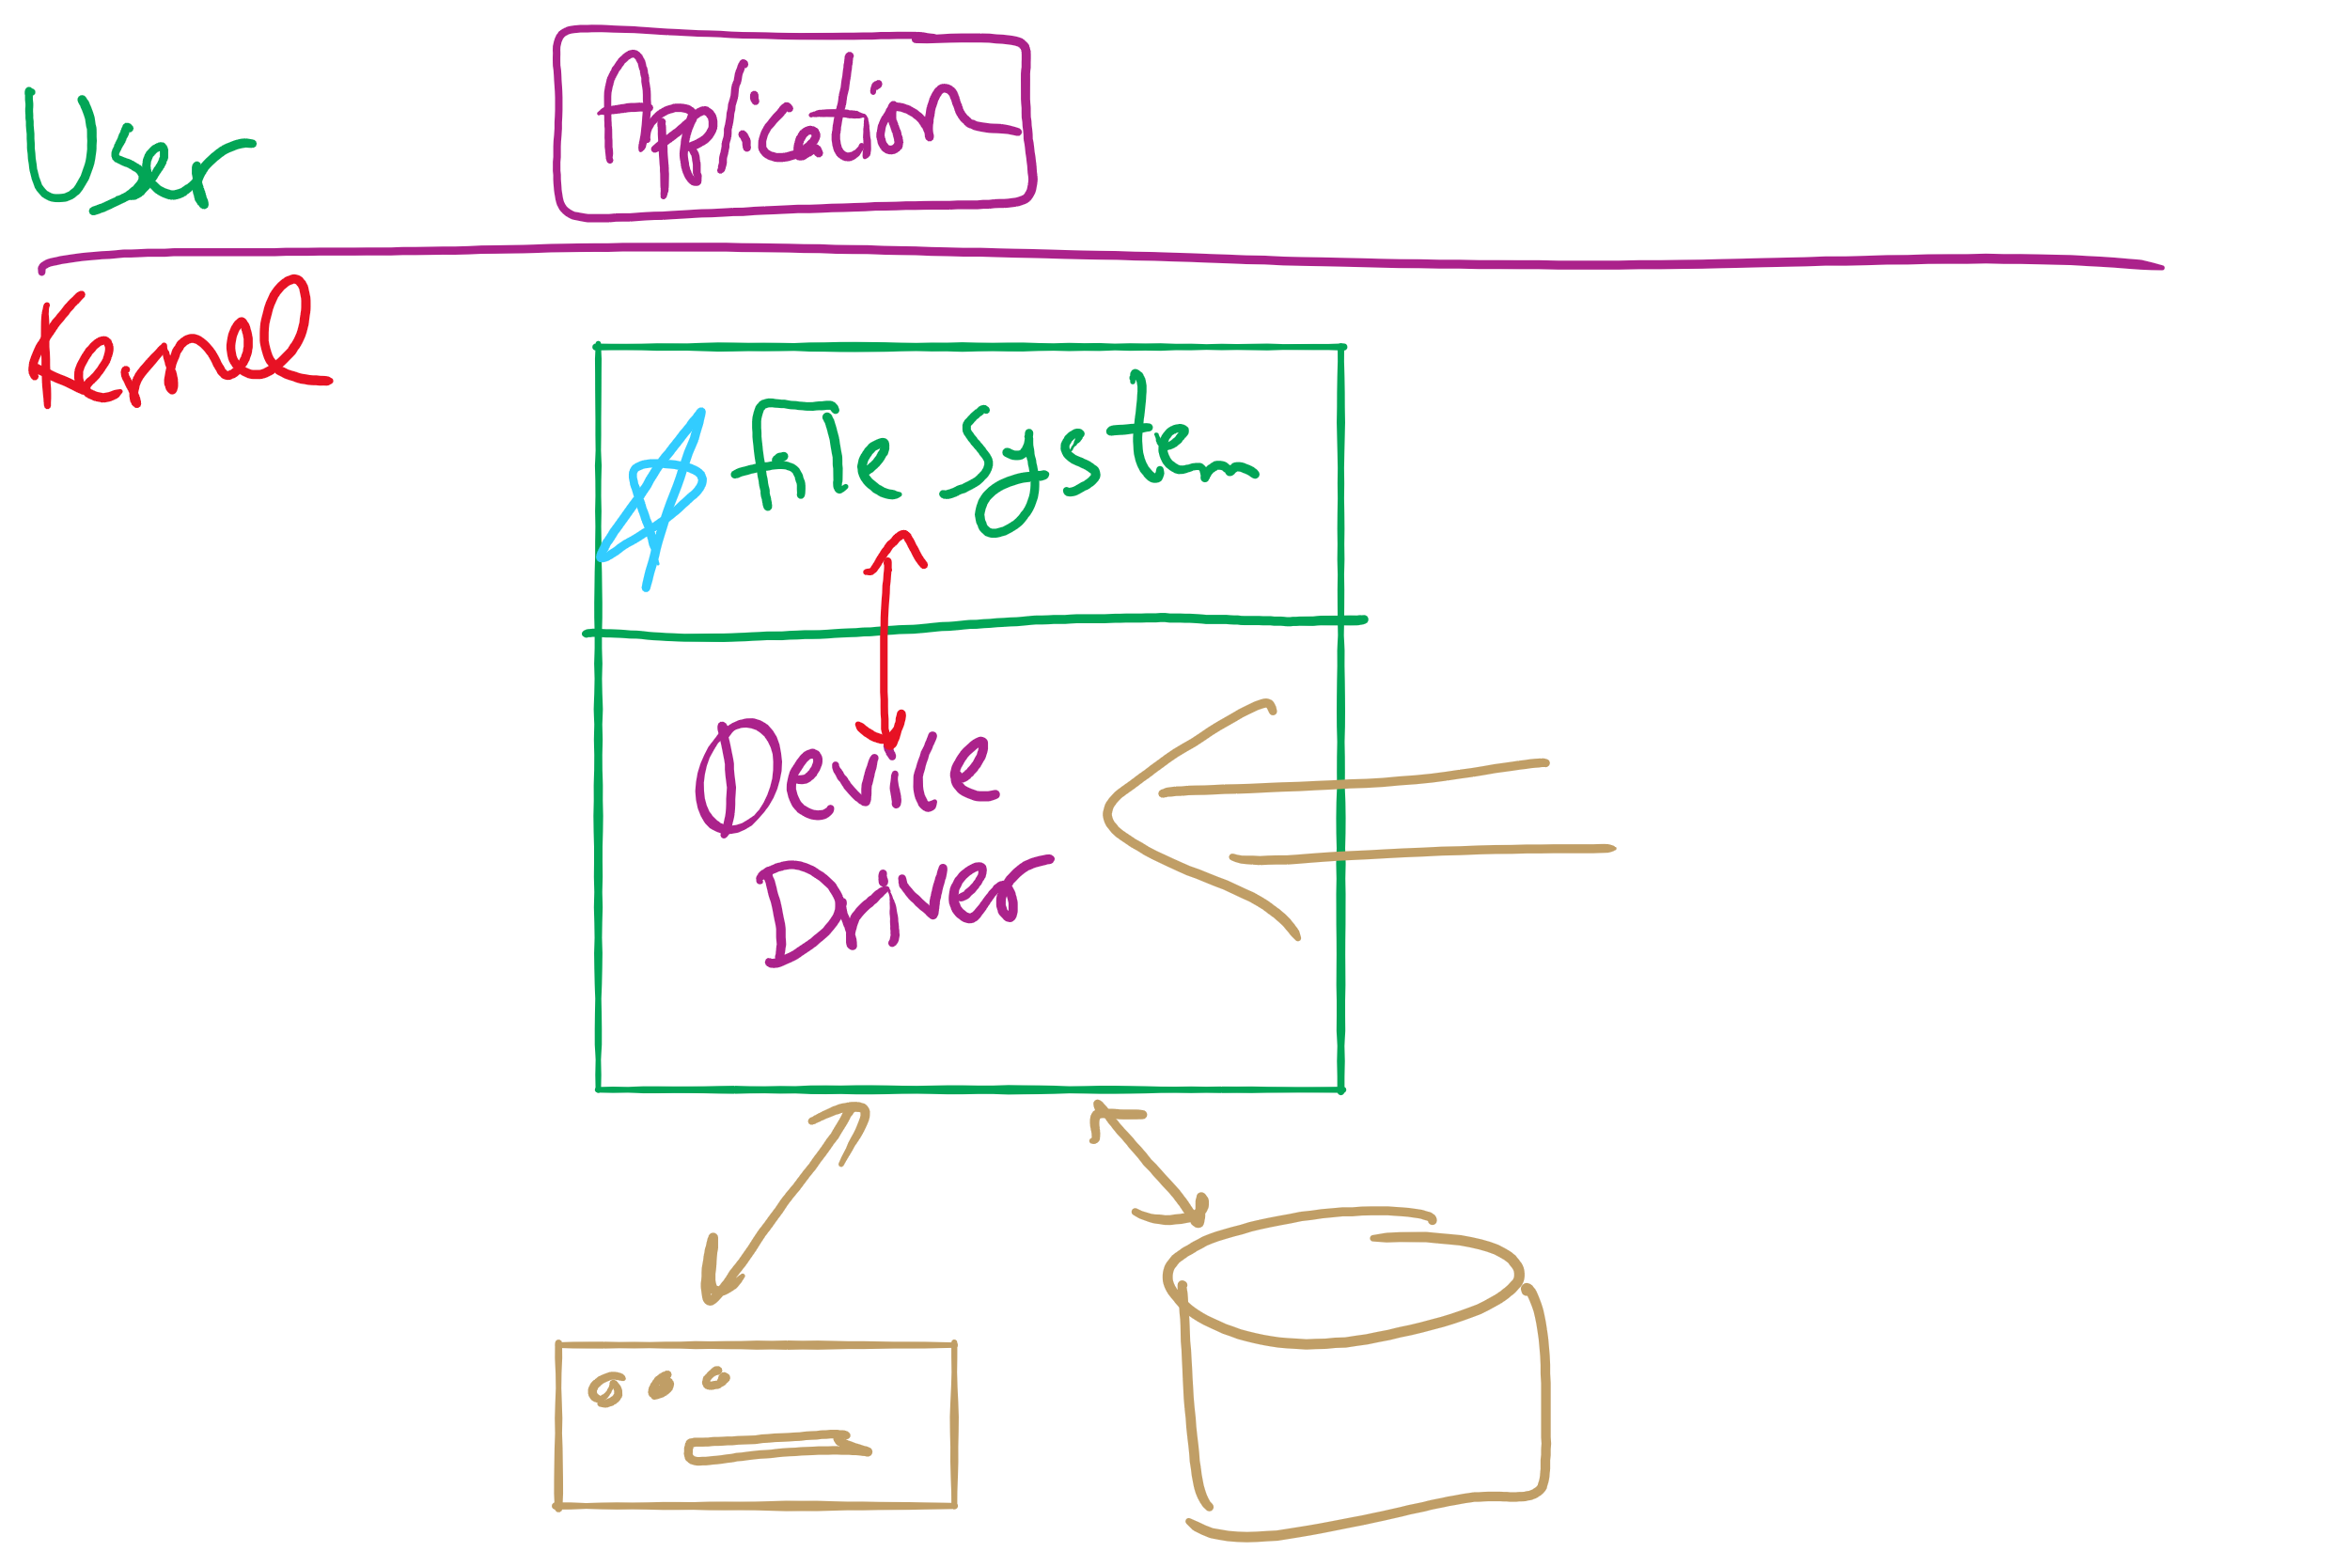
Software Layers

Slide 6
Question of the Day
How does a file system handle errors?
Answer: Defense in Depth
multiple layers of error detection/correction

Slide 7
Device drivers
Device drivers go between device controllers and rest of OS
Drivers standardize interface to widely varied devices
Device drivers communicate with controllers over bus
Controllers communicate with devices themselves
User space
User program
Kernel space
Rest of the OS
Keyboard driver
Disk driver
Keyboard controller
Disk controller

Slide 8
Layers of I/O software
User-level I/O software & libraries
User
Device-independent OS software
Operating system (kernel)
Device drivers
Interrupt handlers
Hardware

Slide 9
Device Driver goals
Device independence
Programs can access any I/O device
No need to specify device in advance
Uniform naming
Name of a file or device is a string or an integer
Doesn’t depend on the machine (underlying hardware)
Error handling
Done as close to the hardware as possible
Isolate from higher-level software
Synchronous vs. asynchronous transfers
Blocked transfers vs. interrupt-driven
Buffering
Data coming off a device cannot be stored in final destination right away
Arbitration of device access
Sharable vs. dedicated devices

Slide 10
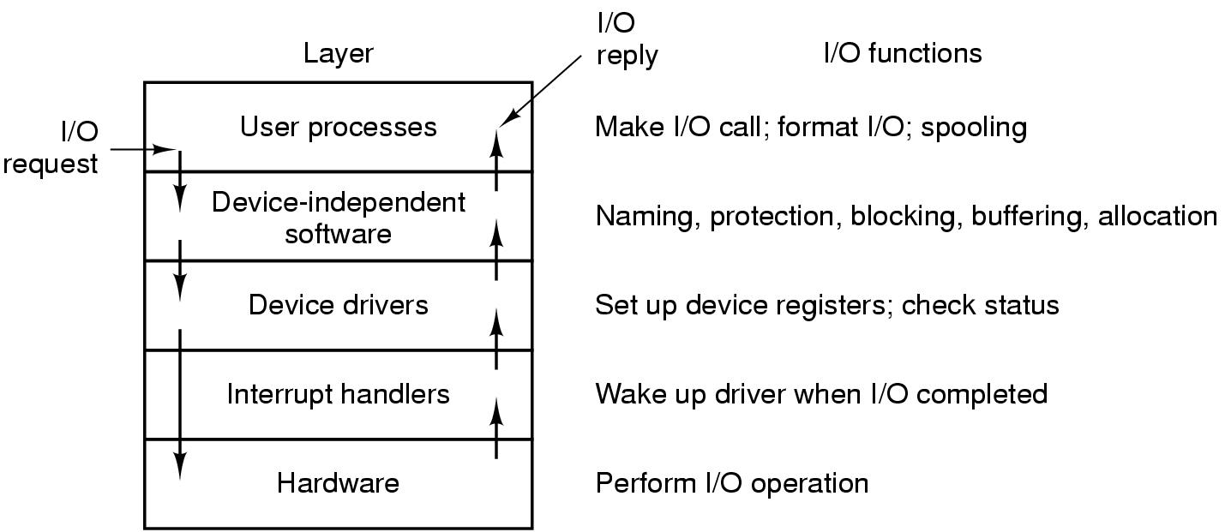
Anatomy of an I/O request

Slide 11
Disk drive structure
Data stored on surfaces
One or more platters per disk
Up to two surfaces per platter
Data in concentric tracks
Tracks broken into sectors
256B-1KB per sector
Cylinder: corresponding tracks on all surfaces
Data read and written by heads
Actuator moves heads
Heads move in unison
head
sector
platter
track
cylinder
surfaces
spindle
actuator

Slide 12
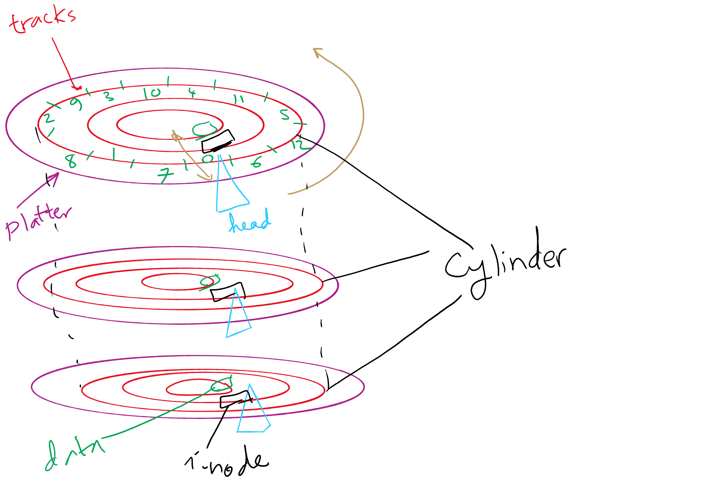
Disks, cylinders, cylinder groups

Slide 13
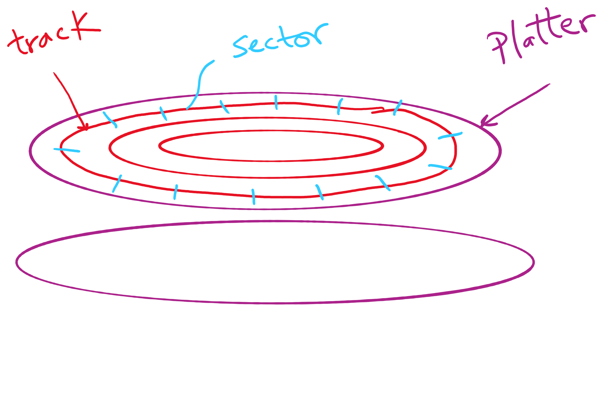
Disk Sector

Slide 14
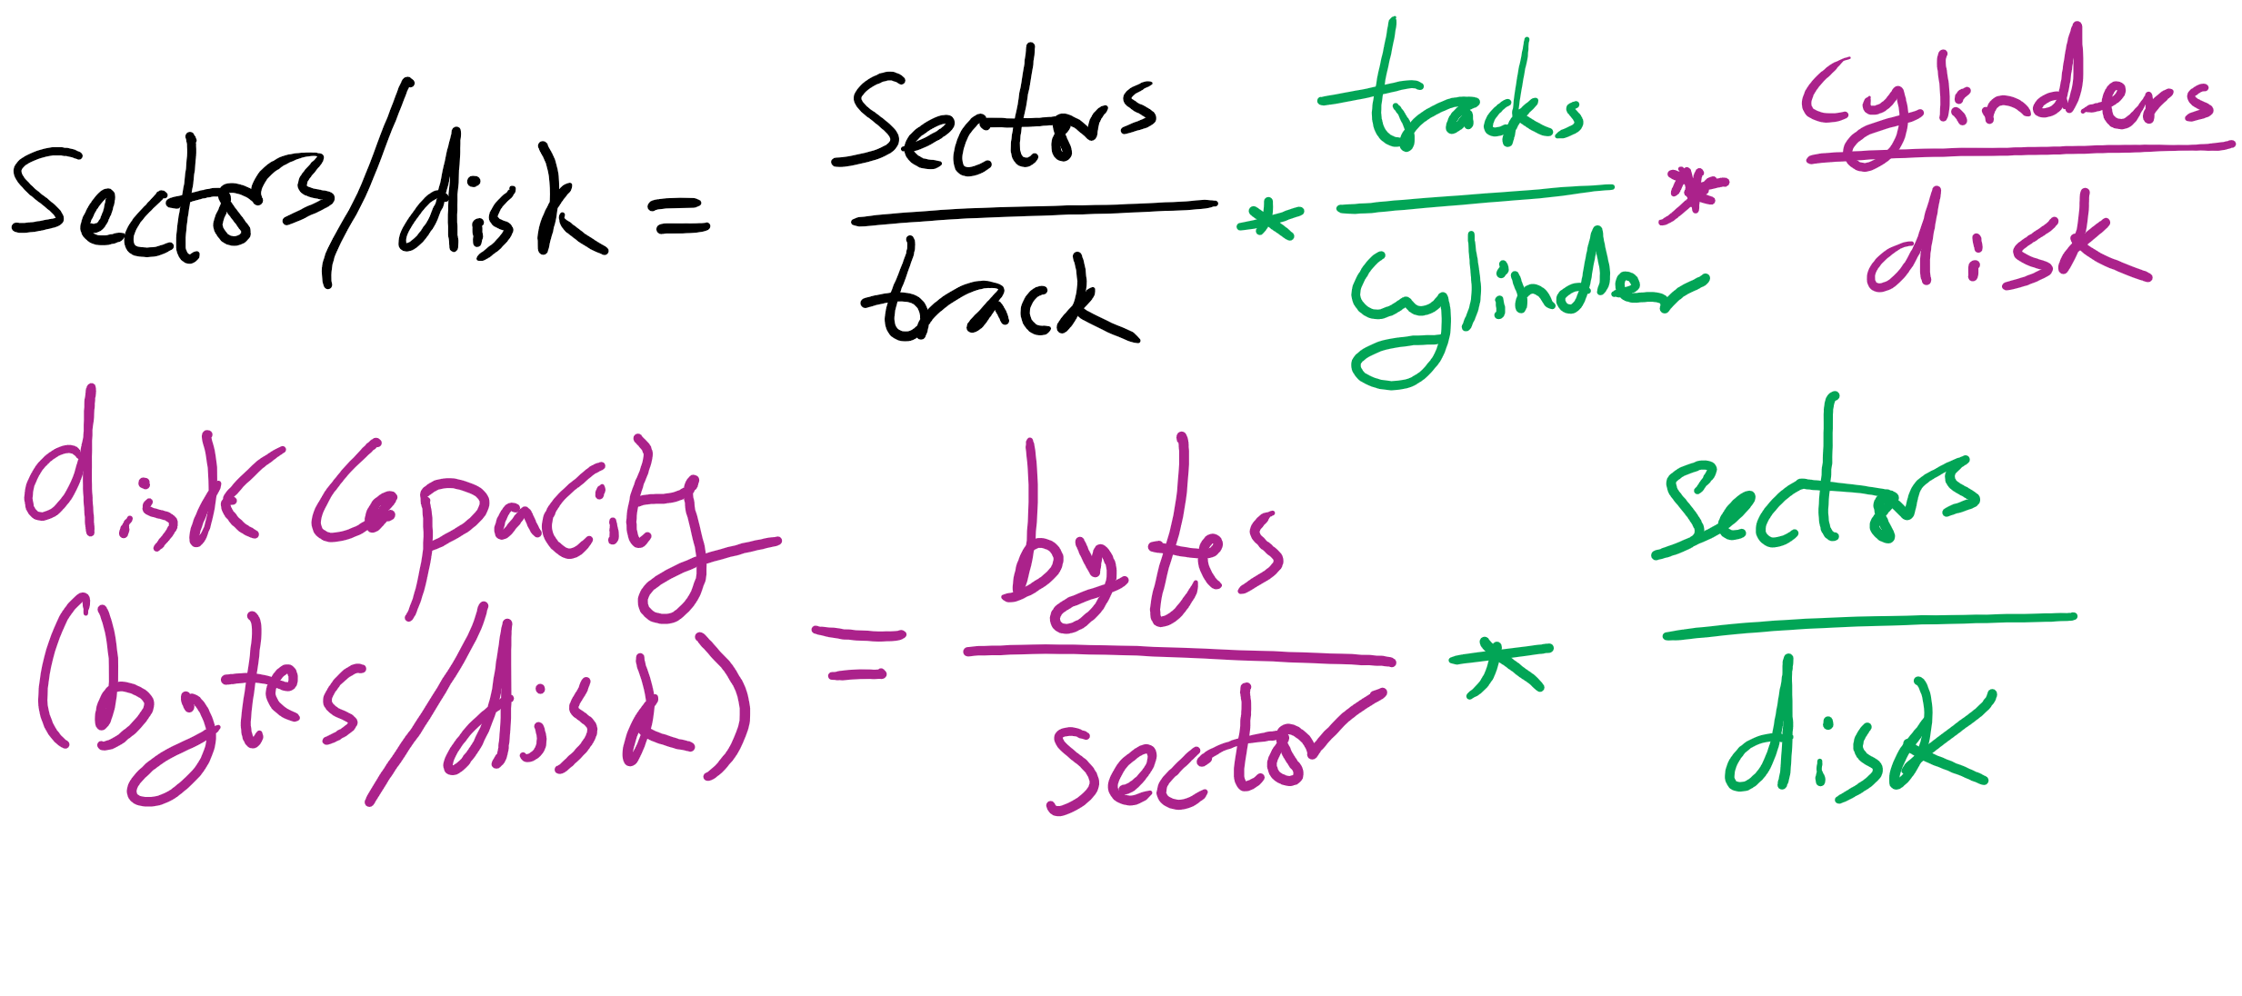
Disk Size

Slide 15
What’s in a disk request?
Time required to read or write a disk block determined by 3 factors
Seek time: move disk arm to track
Rotational delay
Average delay = 1/2 rotation time
Example: one rotation in 10ms → average rotational delay = 5ms
Actual transfer time
Transfer time = time to rotate sector(s) under the heads
Example: one rotation in 10ms, 200 sectors/track
10/200 ms = 0.05ms transfer time per sector
Seek time dominates, with rotation time close

Slide 16
Intelligent Seek (IntelliSeek)
Sometimes we don’t need to move disk arm at max speed during seek time
Adjust disk arm speed so that it reaches track right before needed sector is under the head
head
sector
platter
track
cylinder
surfaces
spindle
actuator

Slide 17
Disk drive specifics
 | IBM 360KB floppy | WD 18GB HD
Cylinders | 40 | 10601
Tracks per cylinder | 2 | 12
Sectors per track | 9 | 281 (average)
Sectors per disk | 720 | 35742000
Bytes per sector | 512 | 512
Capacity | 360 KB | 18.3 GB
Seek time (minimum) | 6 ms | 0.8 ms
Seek time (average) | 77 ms | 6.9 ms
Rotation time | 200 ms | 8.33 ms
Spinup time | 250 ms | 20 sec
Sector transfer time | 22 ms | 17 μsec

Slide 18
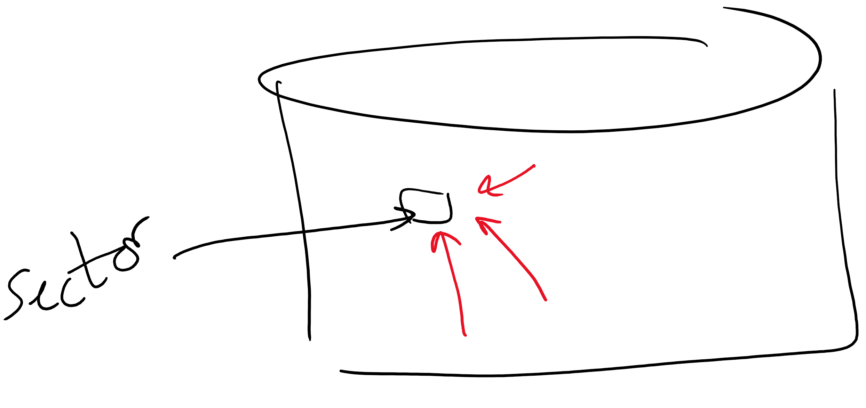
Structure of a disk sector
Preamble contains information about the sector
Sector number & location information
Data is usually 256, 512, or 1024 bytes
ECC (Error Correcting Code) is used to detect & correct minor errors in the data
Preamble
Data
ECC

Slide 19
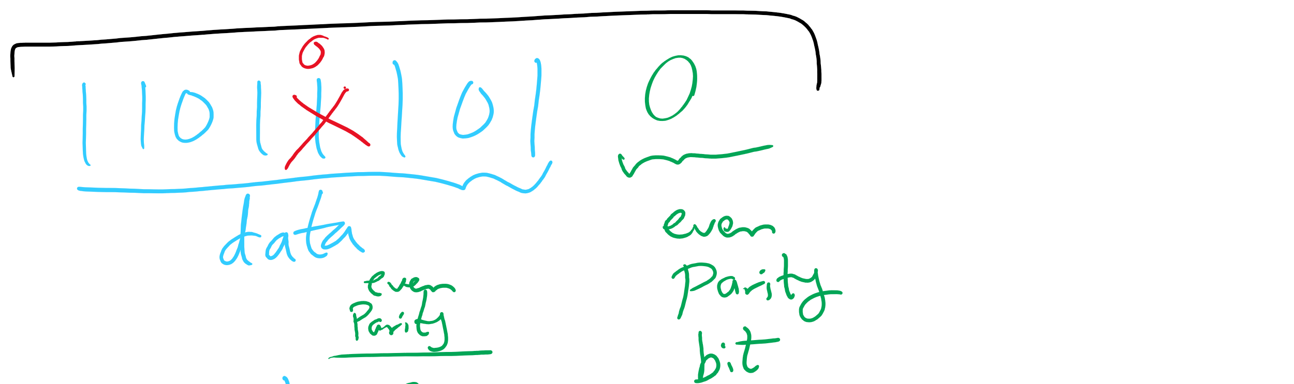
Parity Bit
One parity bit can detect single-bit errors

Slide 20
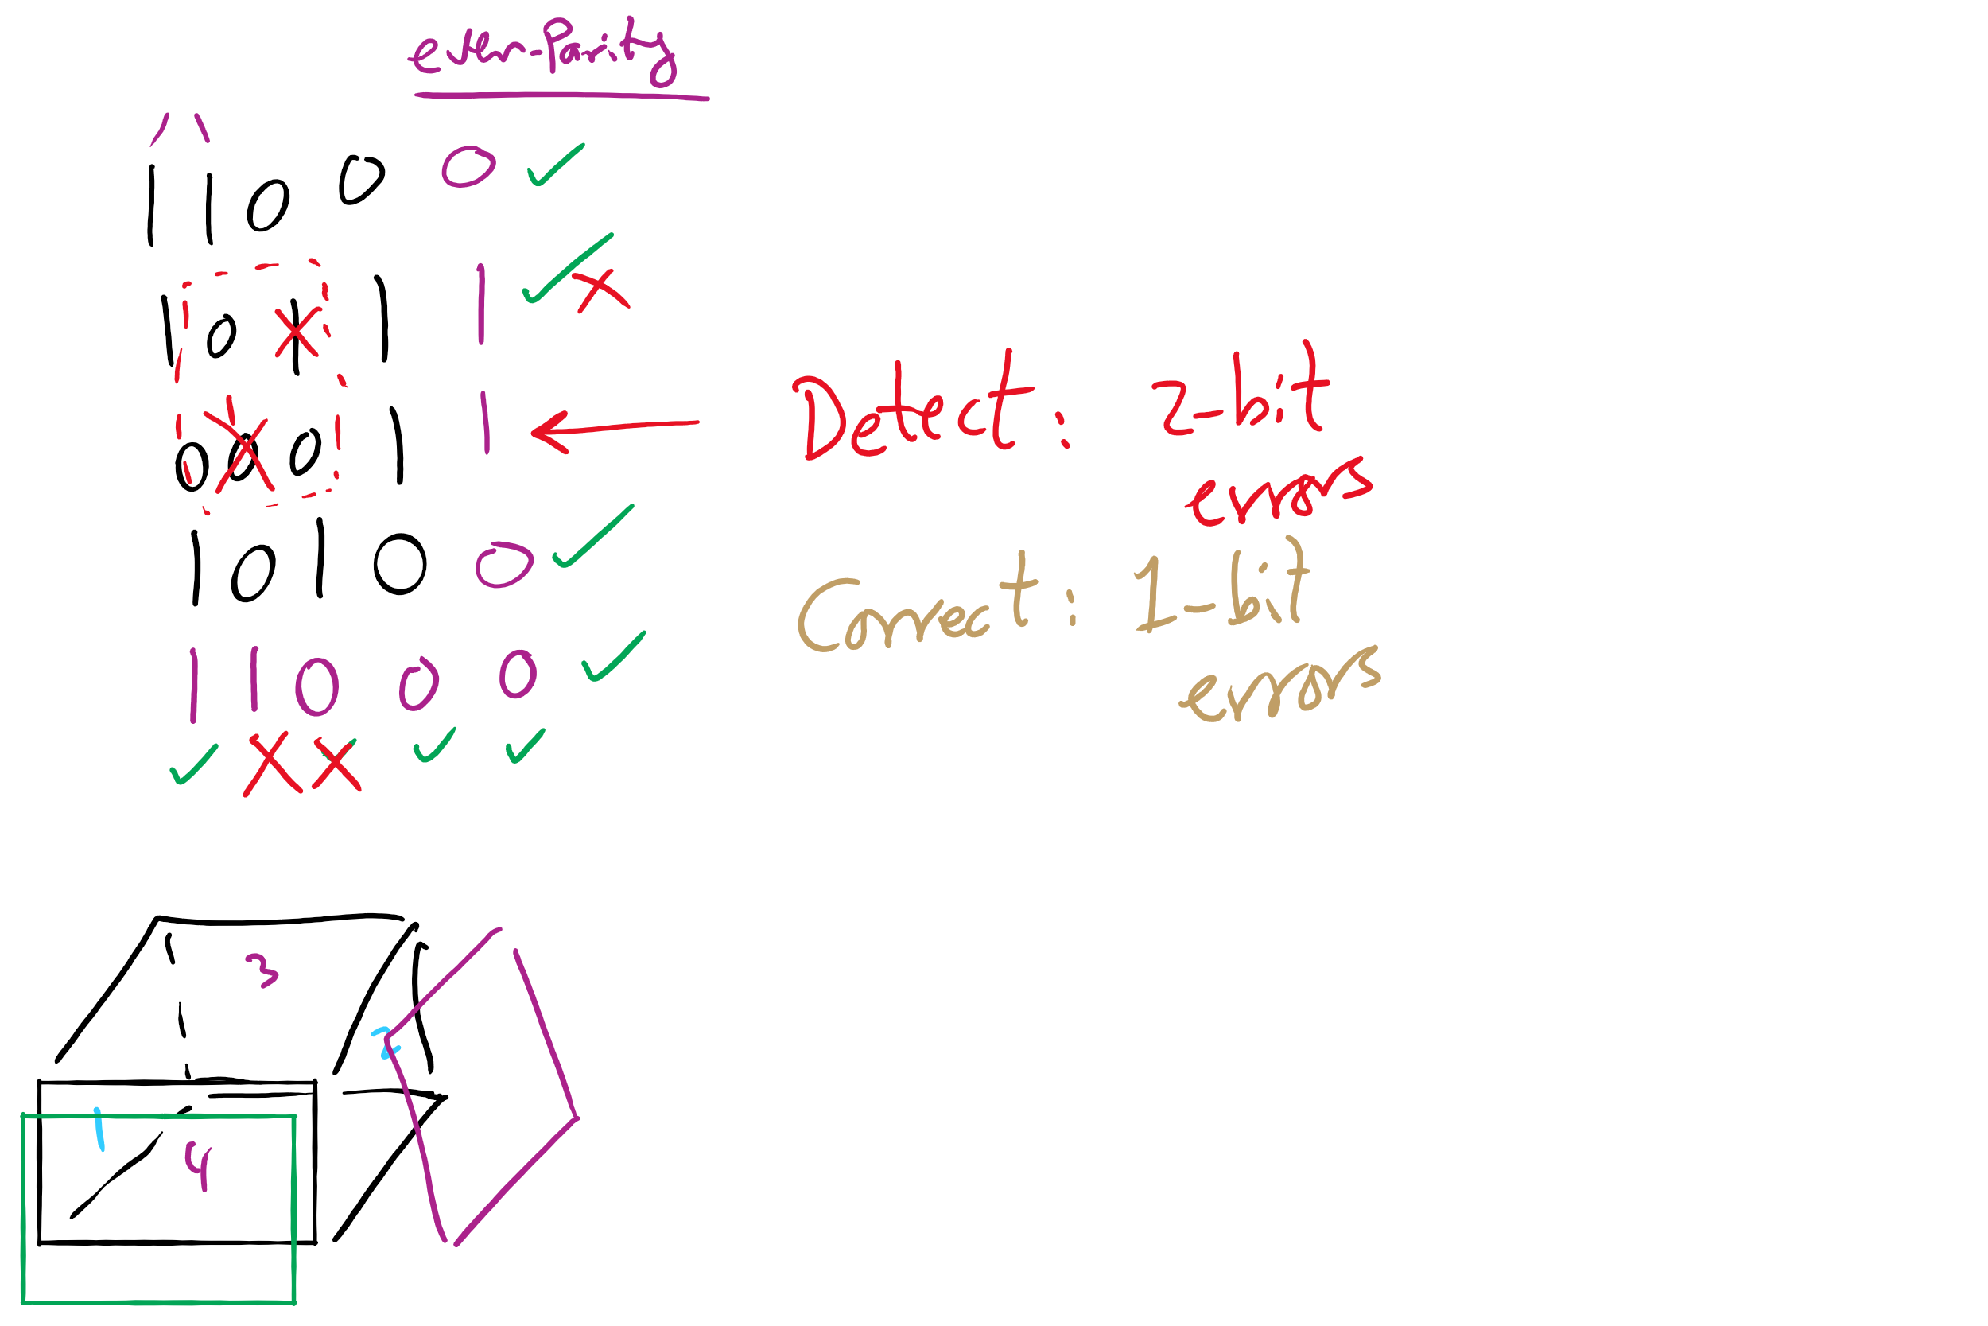
Two-Dimensional Parity Bits

Slide 21
Three-Dimensional Parity Bits
Detect up to 3-bit errors
Correct up to 2-bit errors

Slide 22
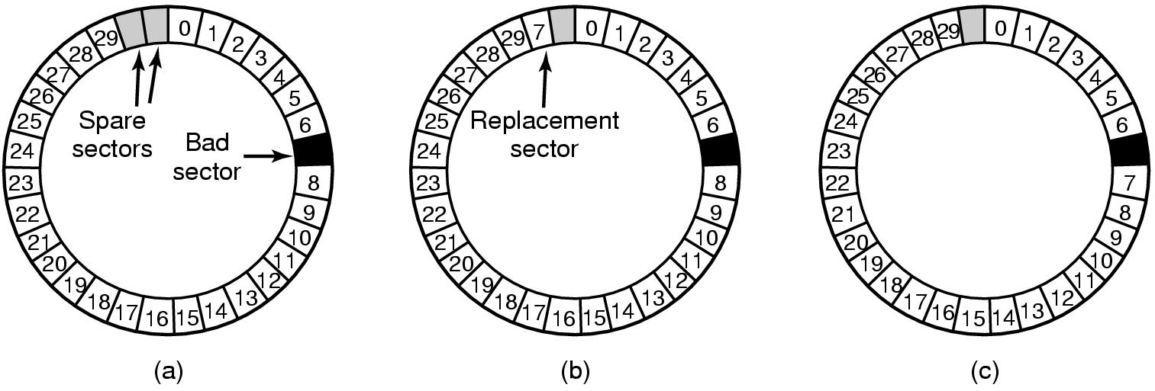
When good disks go bad…
Disks have defects
In 3M+ sectors, this isn’t surprising!
ECC helps with errors, but sometimes this isn’t enough
Disks keep spare sectors (normally unused) and remap bad sectors into these spares
If there’s time, the whole track could be reordered…

Slide 23
What if an entire disk goes bad?
Stripe
strip
strip
RAID 0
(Redundant Array of Inexpensive Disks
RAID 1
(Mirrored copies)
RAID 4
(Striped with parity)
RAID 5
(Parity rotates through disks)

Slide 24
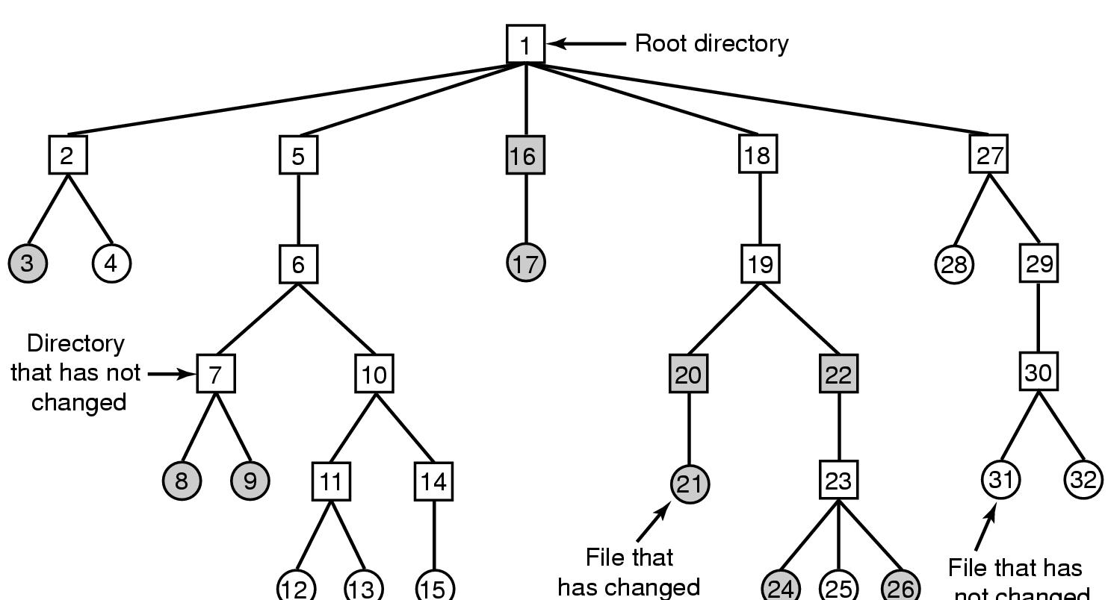
What if RAID cannot mask an error?
Solution: Backing up a file system (aka dumping)
Expensive operation → done incrementally
Track items modified since last dump (shaded)
Numbers are i-node numbers
File that has
not changed

Slide 25
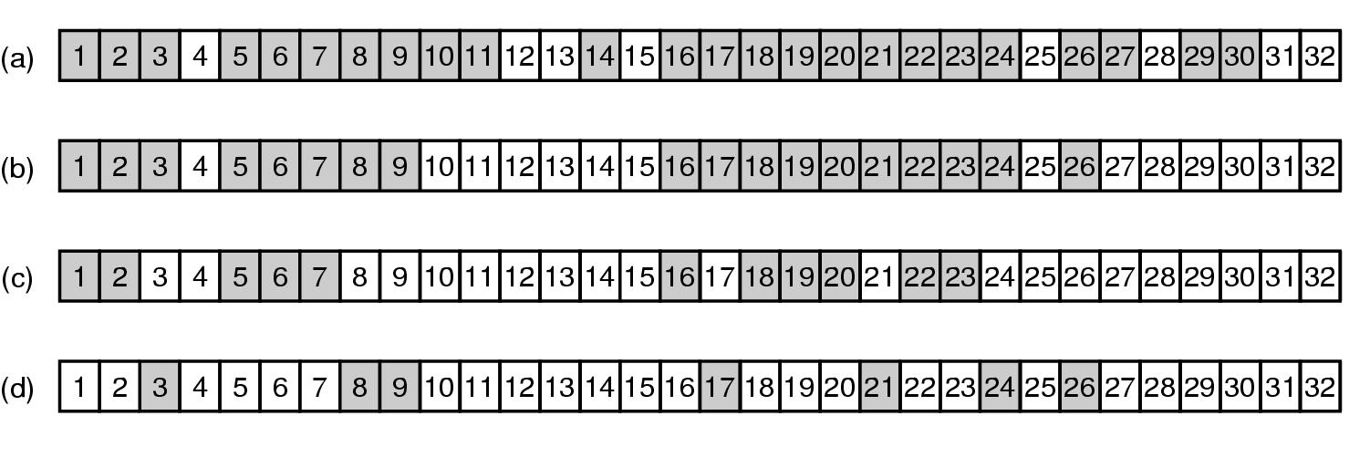
Incremental dump using bitmaps

Slide 26
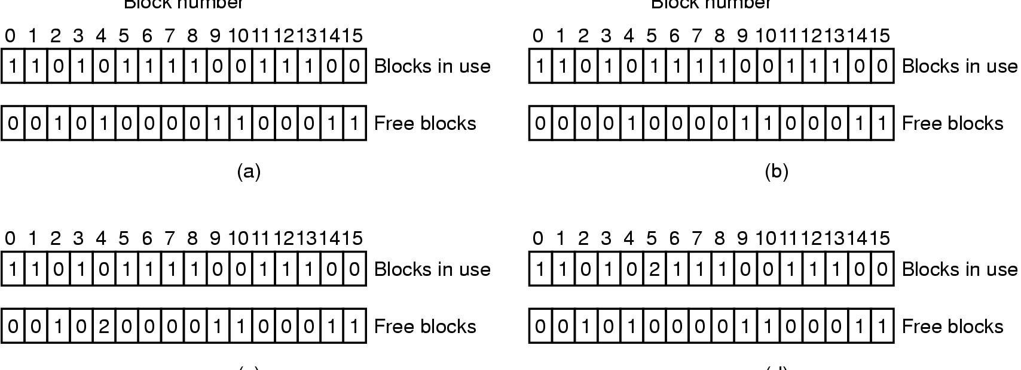
What if errors happen in metadata?
Reason: power failure during an operation
file system consistency check
Consistent
Missing (“lost”) block
Duplicate block in free list
Duplicate block in two files

Slide 27
Problem of the Day – Part 2
How does a file system hide disk access delays?
Answer:
Caching
Optimize the writes

Slide 28
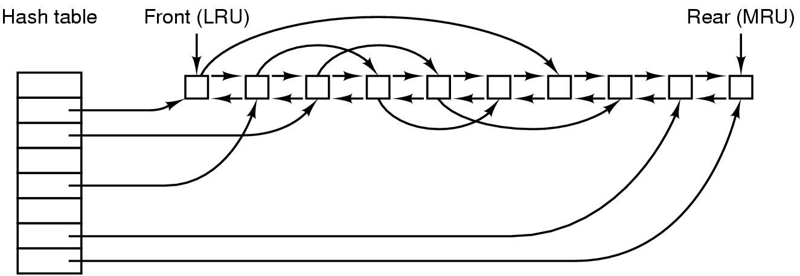
File block cache data structures

Slide 29
Log-structured file systems
Trends in disk & memory
Faster CPUs
Larger memories
Result
More memory -> disk caches can also be larger
Increasing number of read requests can come from cache
Thus, most disk accesses will be writes
LFS structures entire disk as a log
All writes initially buffered in memory
Periodically write these to the end of the disk log
When file opened, locate i-node, then find blocks
Issue: what happens when blocks are deleted?

Slide 30
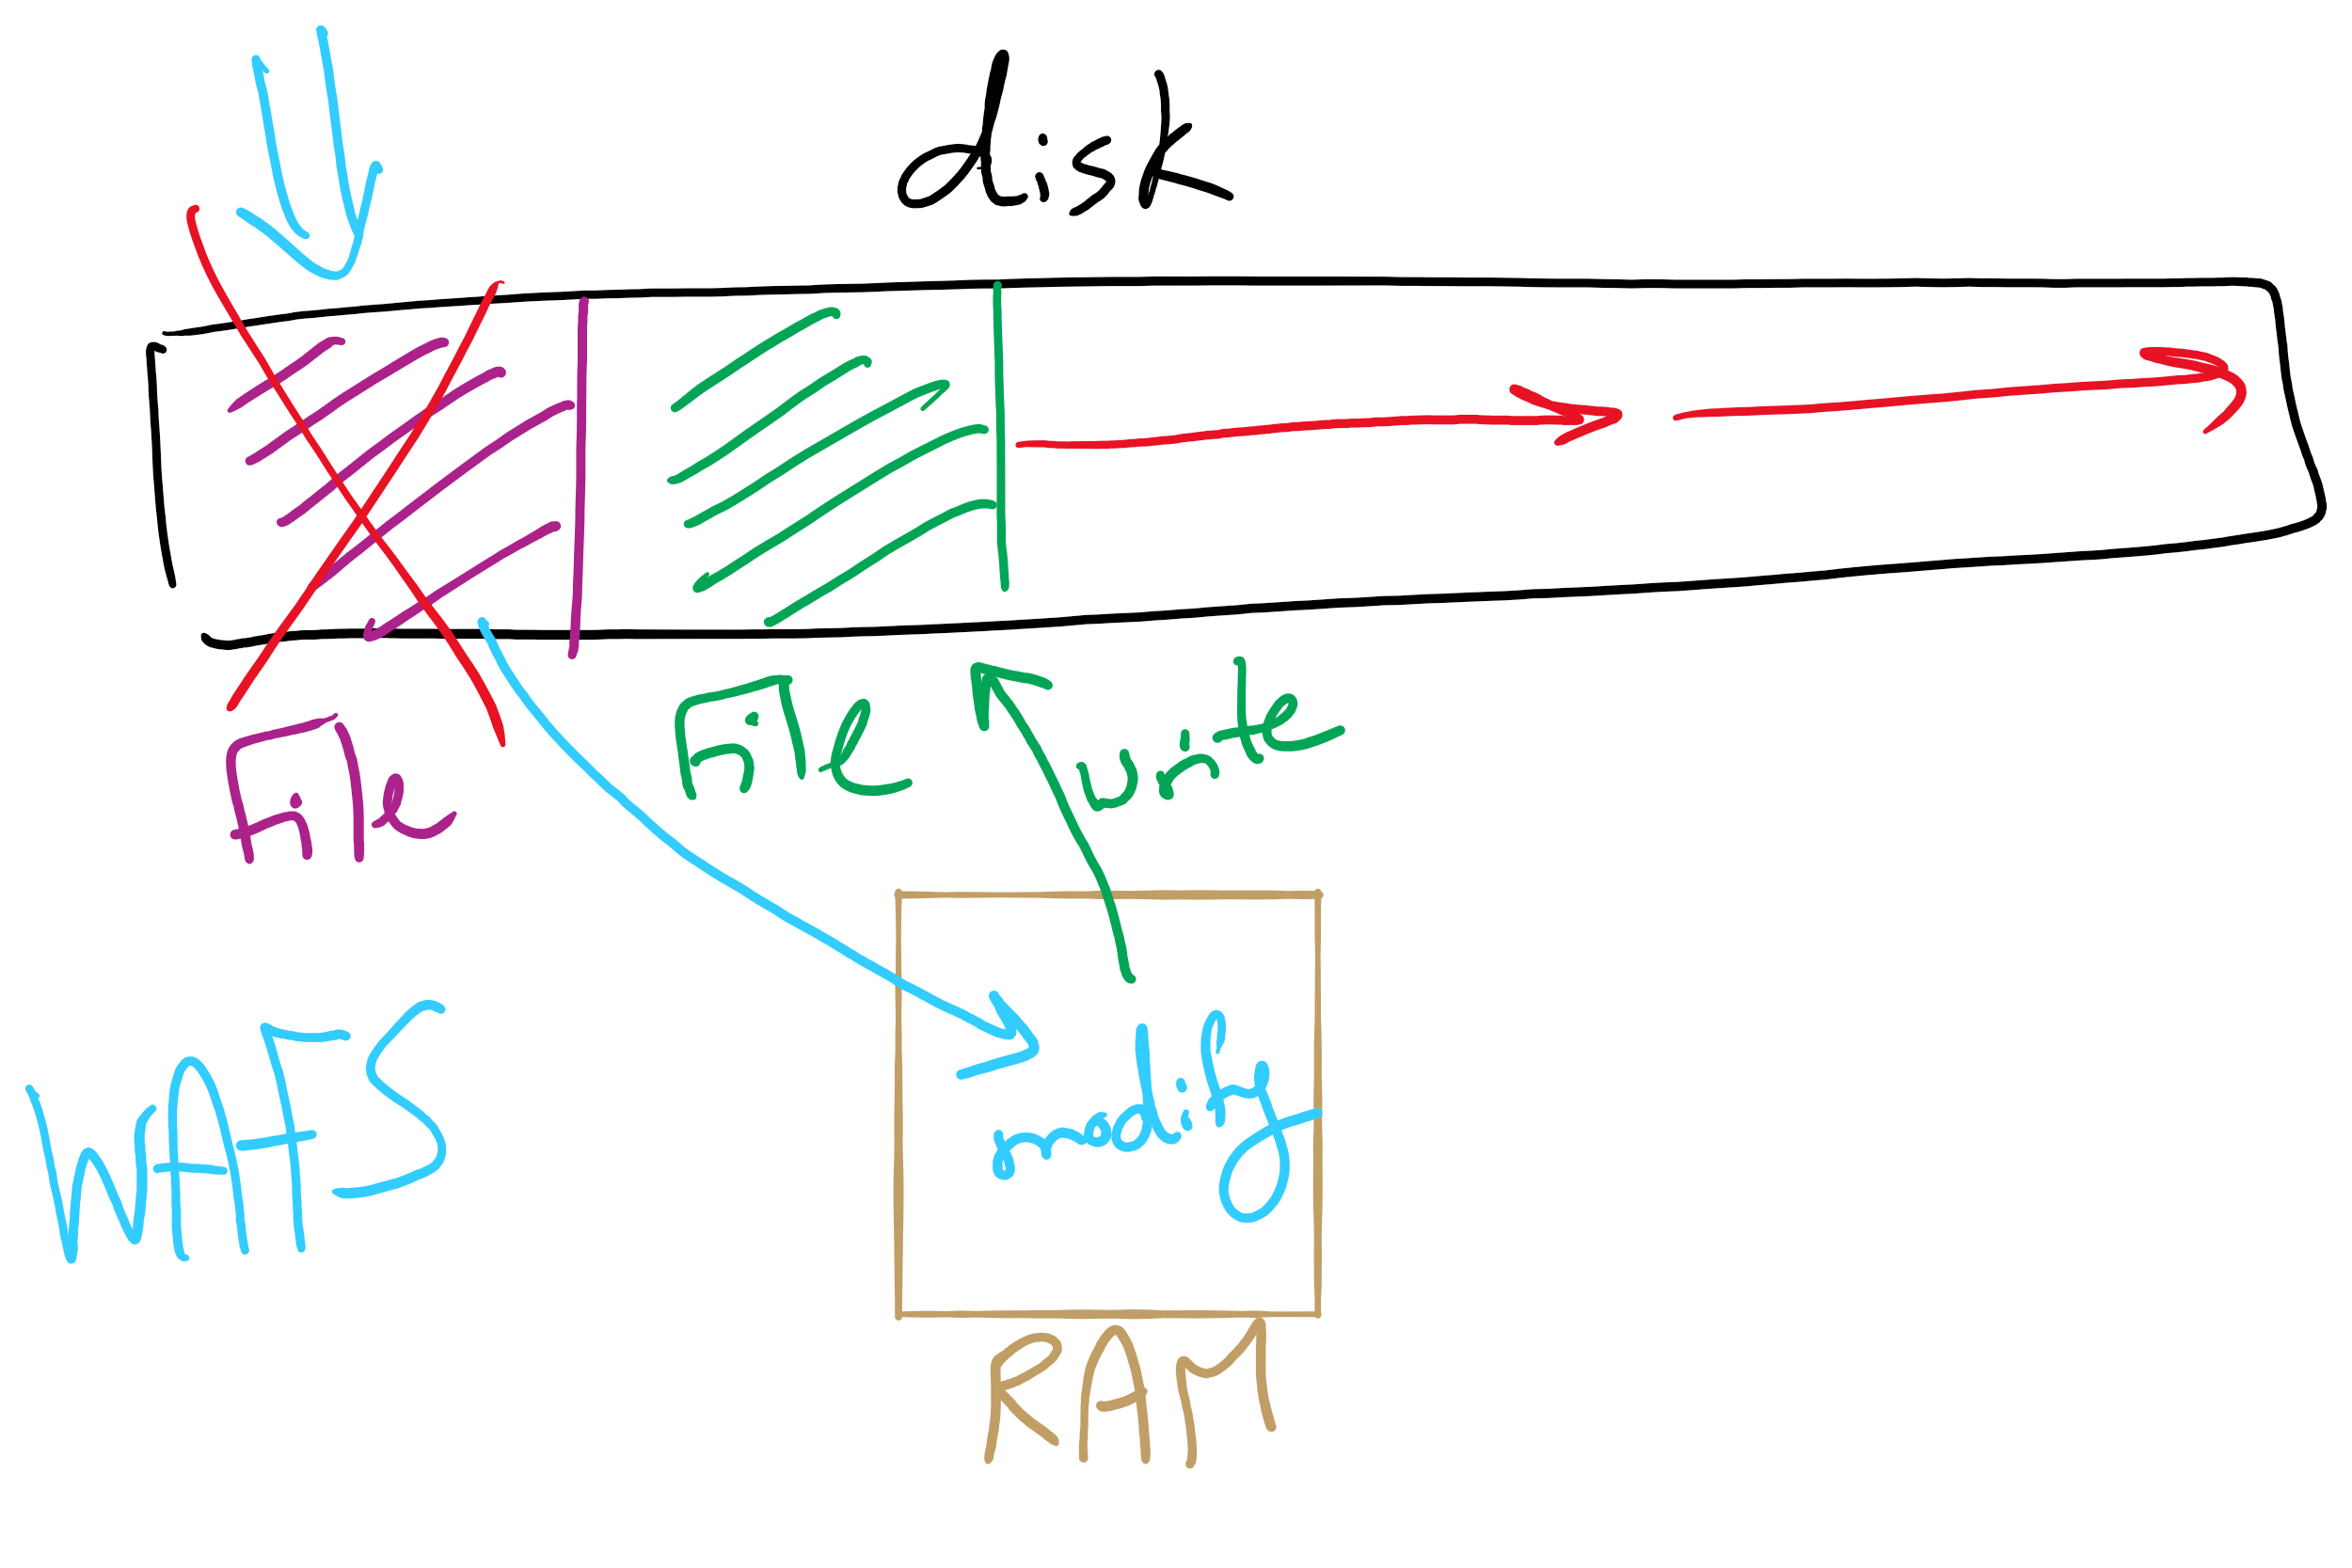
Log Structured File System

Slide 31
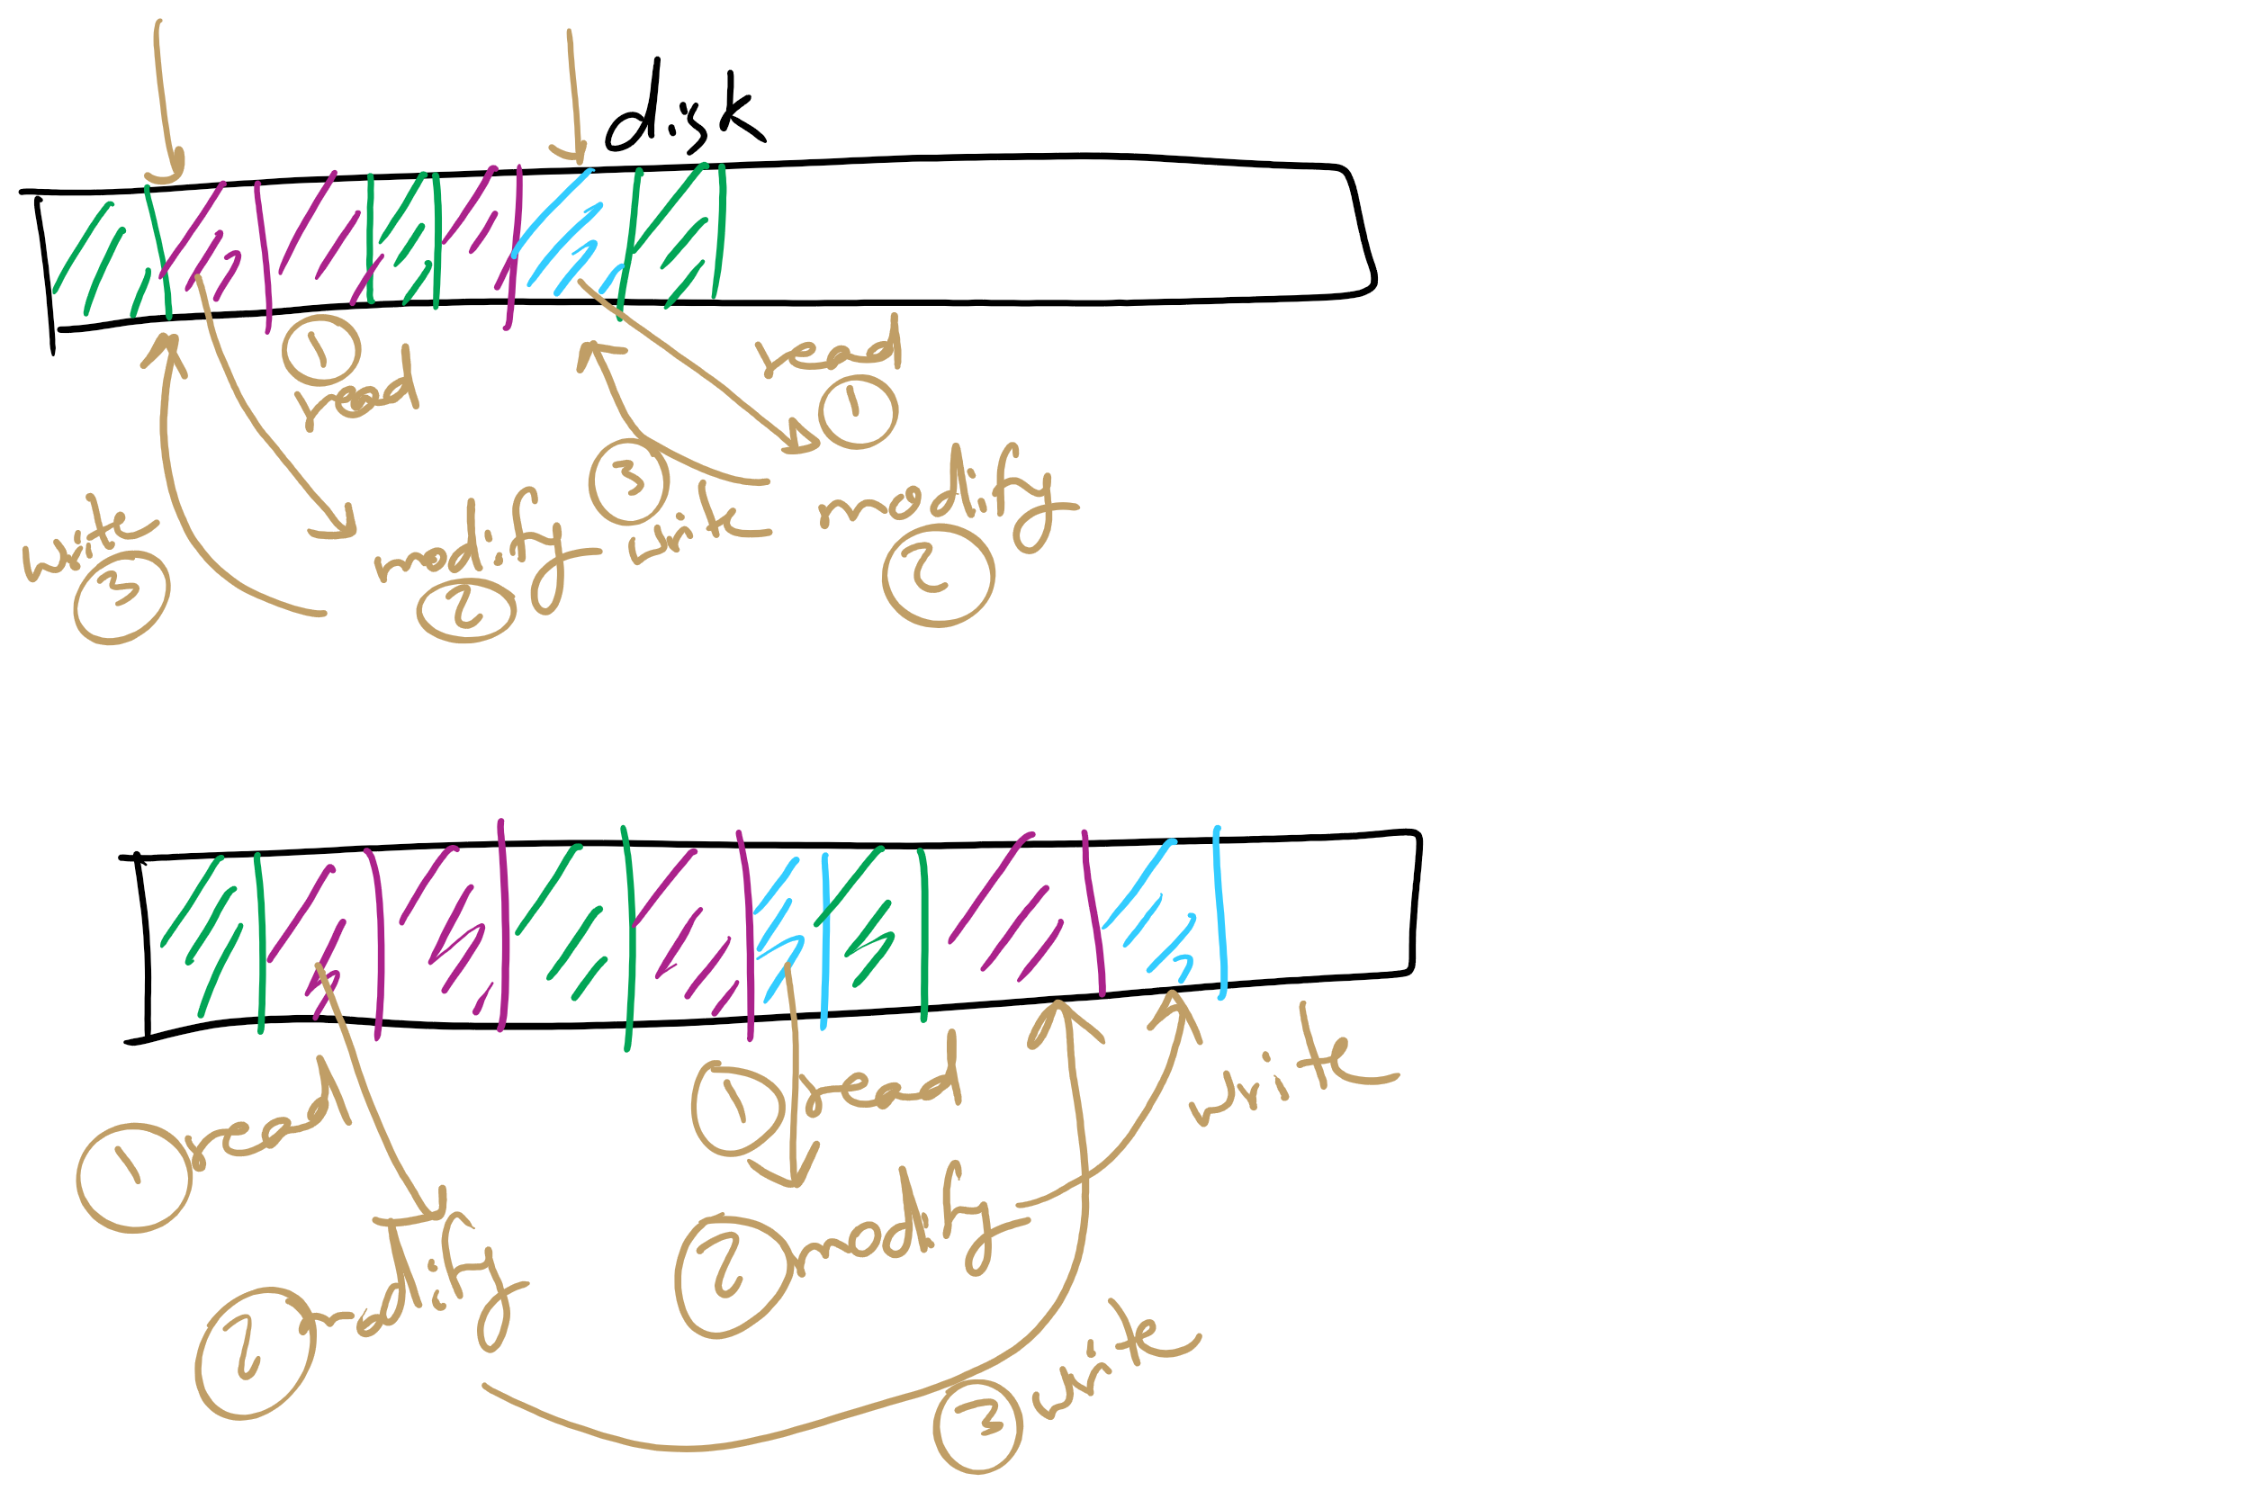
Log Structured File System

Slide 32
Flash File System
Wear Leveling
Count total writes per flash sector and attempt to balance across the whole disk

Slide 33
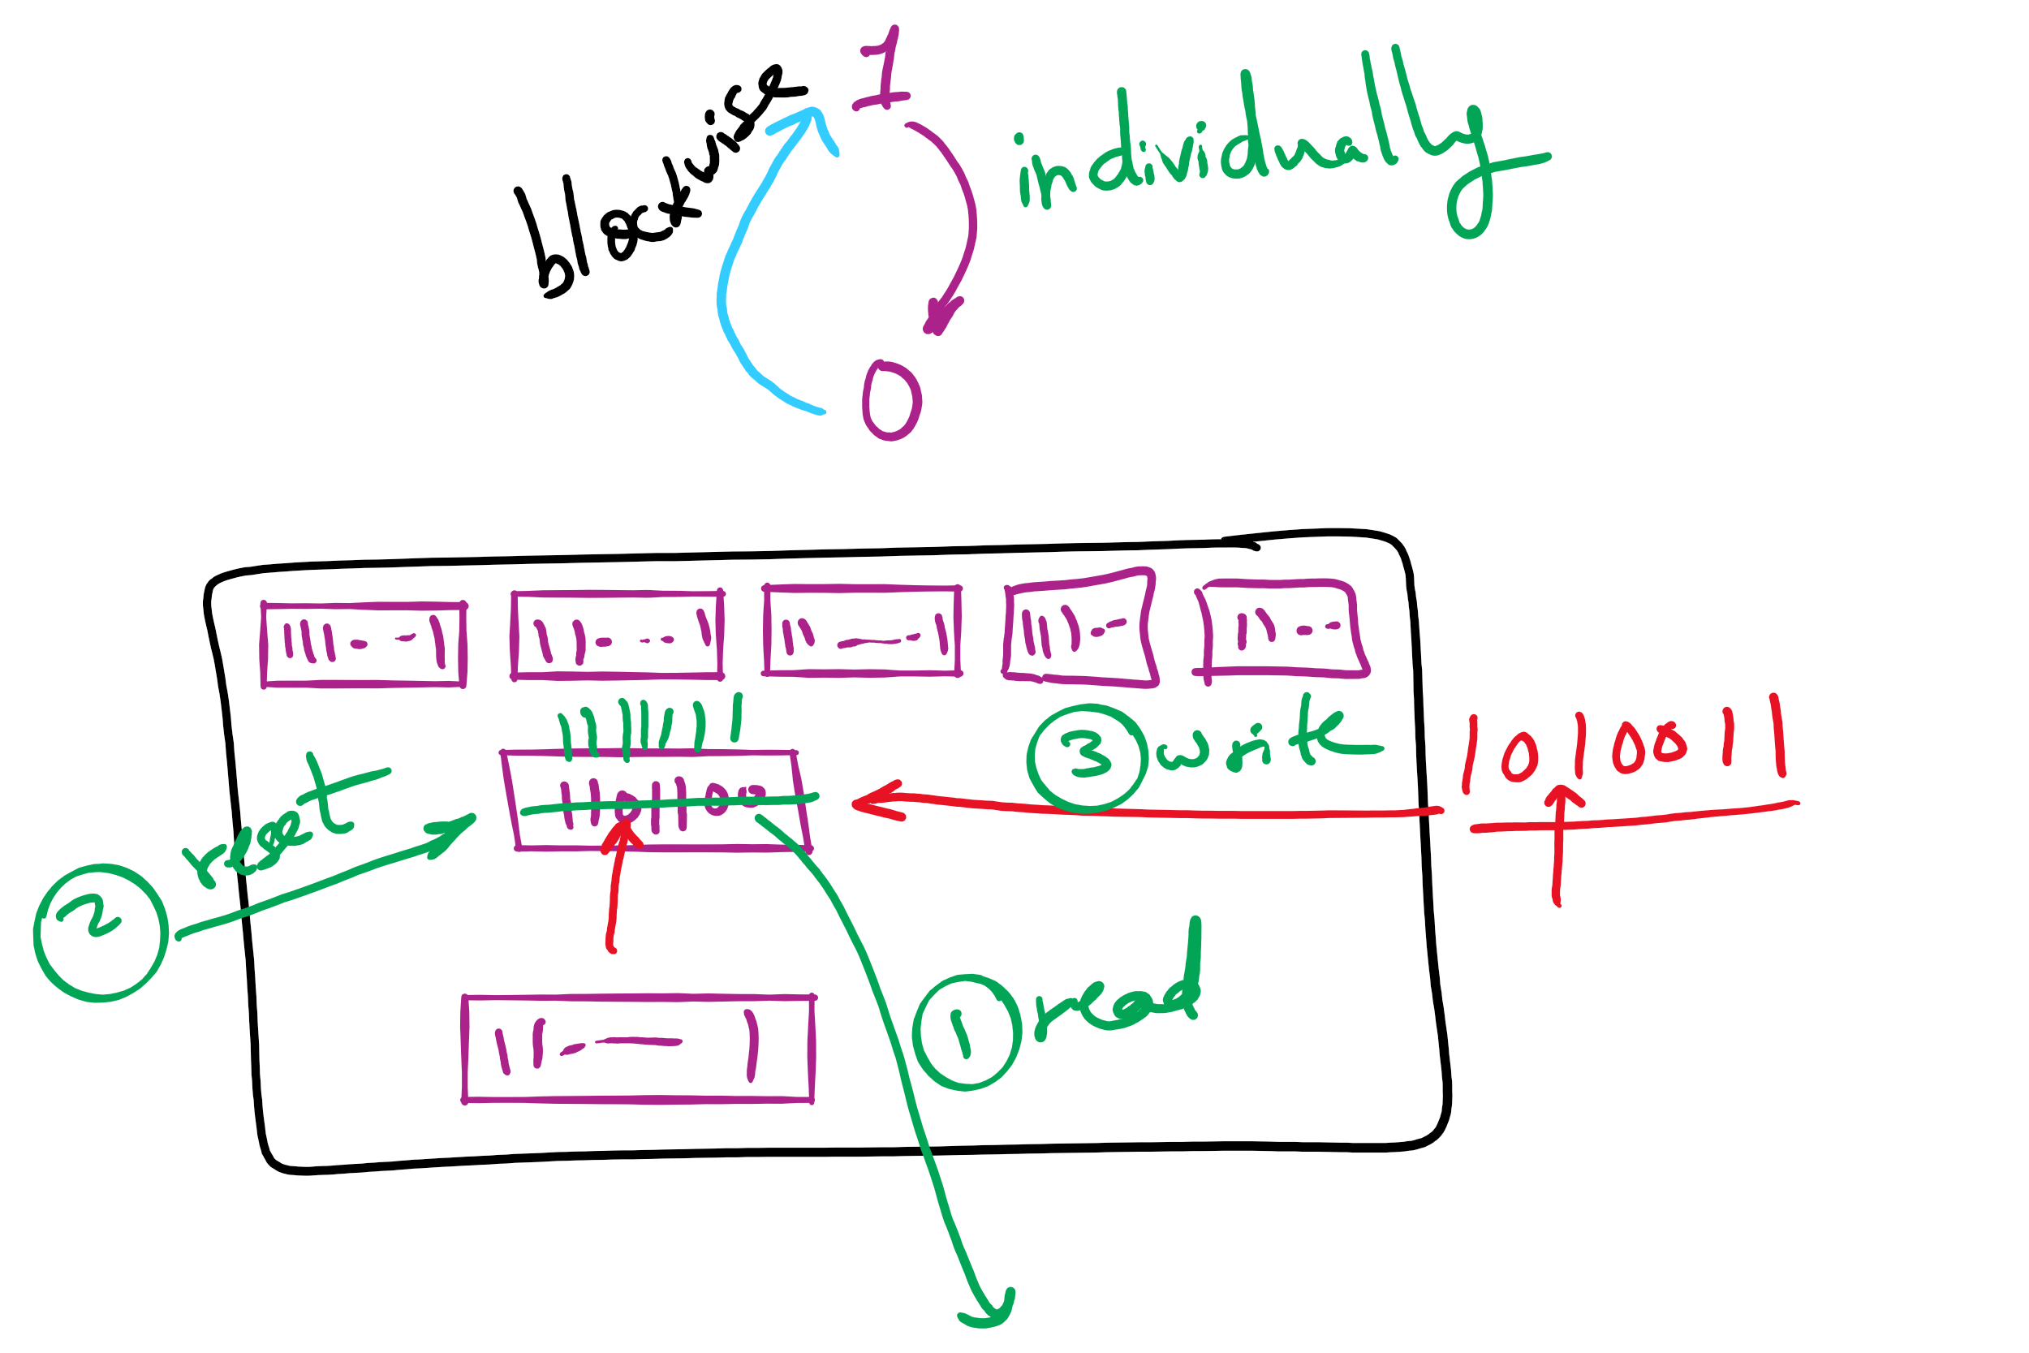
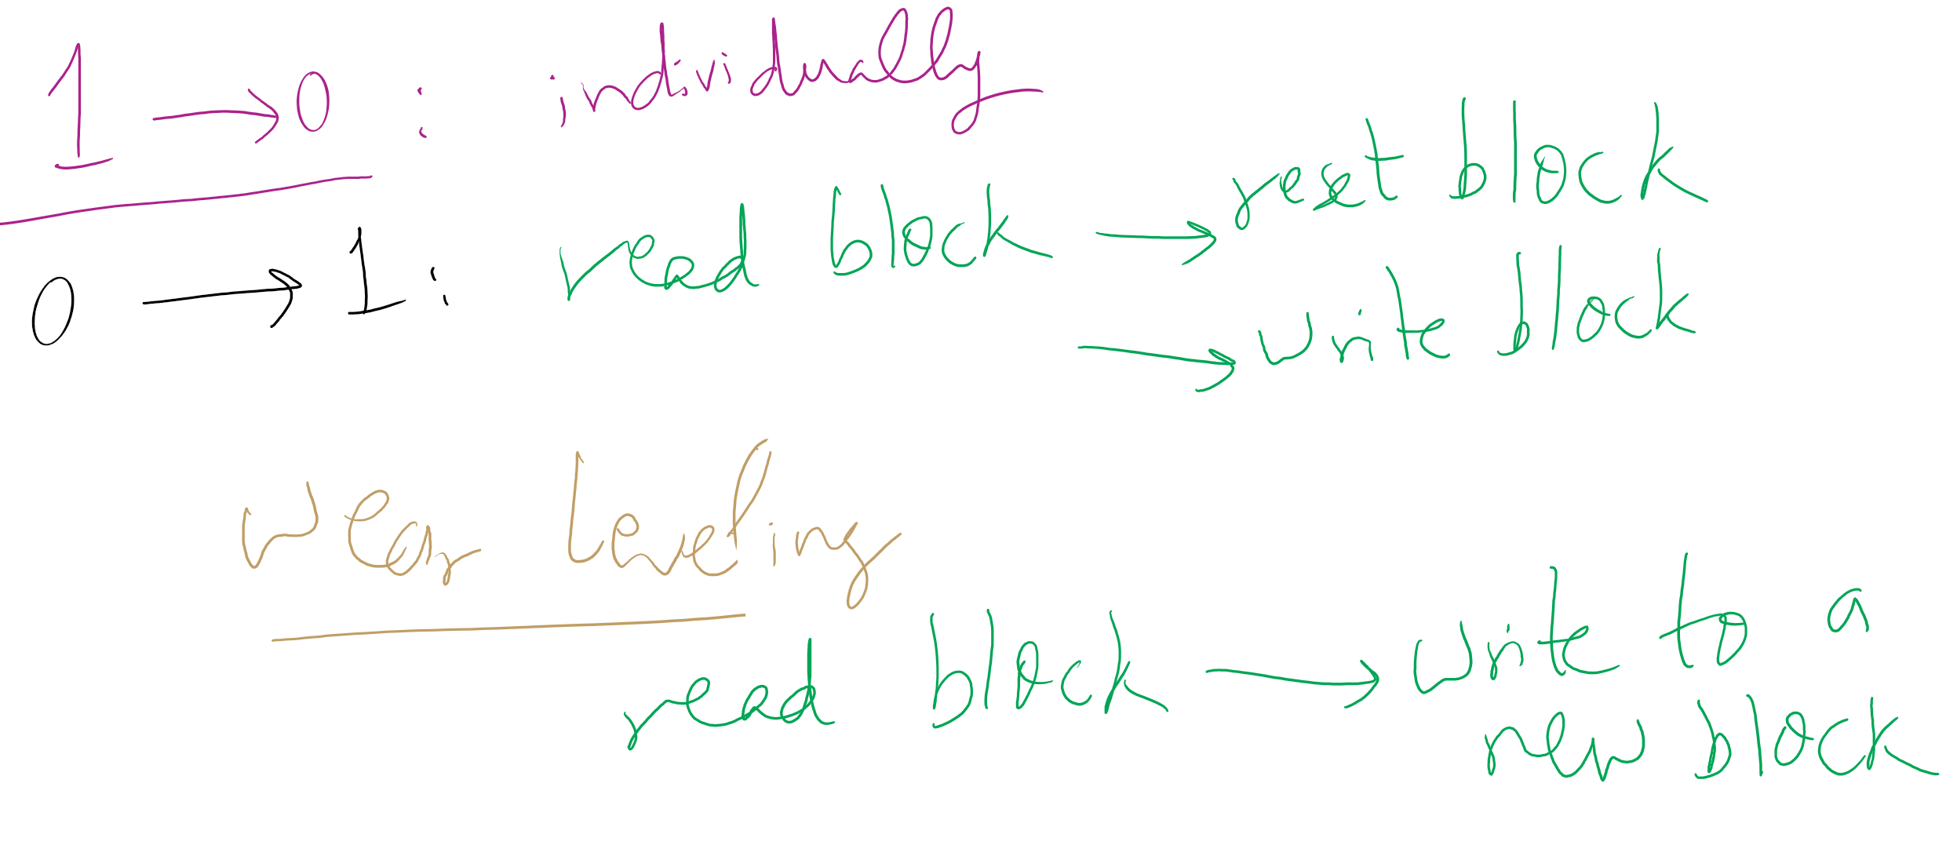
Wear leveling for SSDs

